Slide 1
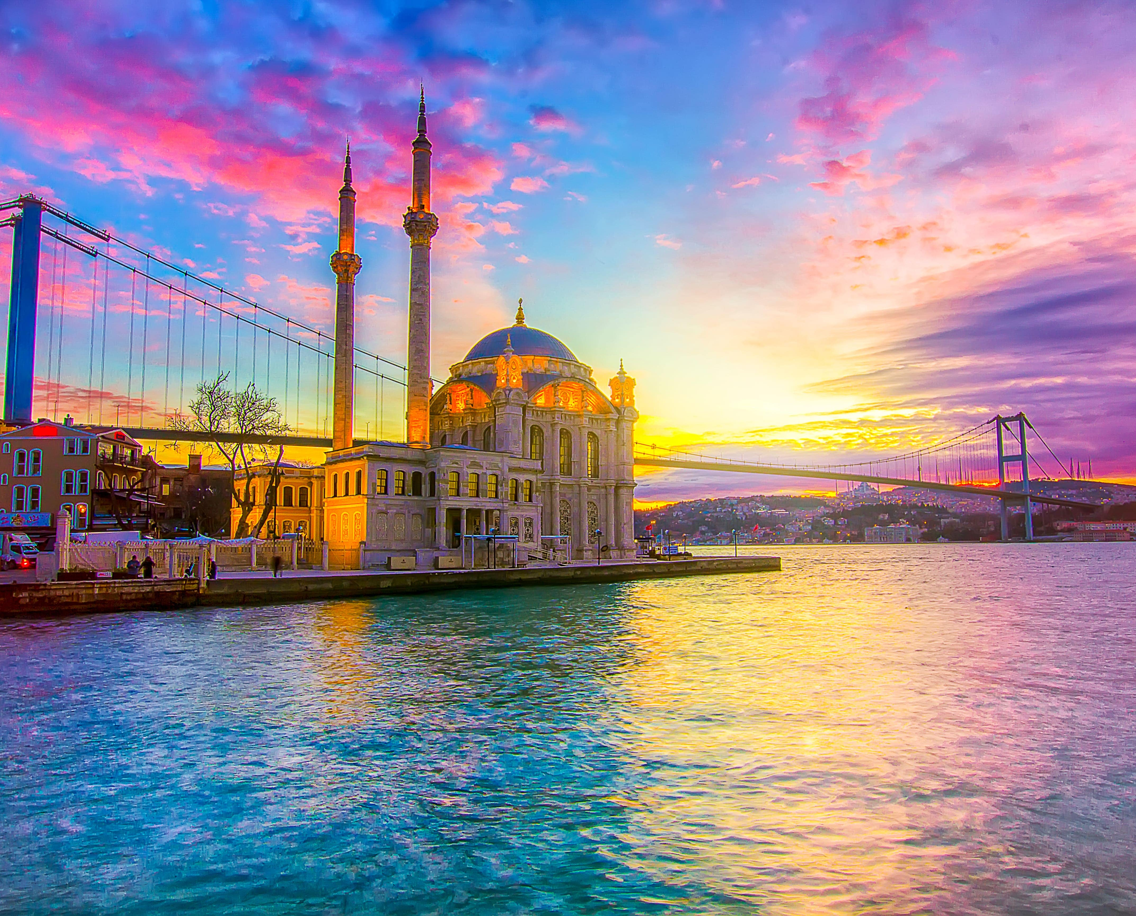

The Contribution of HELLASTRON road Network to the improvement of the Mobility and Road Safety in Greece
Manos Vrailas
HELLASTRON, President,
Nea Odos/Kentriki Odos,
President
Hosted by

Slide 2
Mobility – The HELLASTRON approach
Mobility
Safe
Smart
Sustainable

Slide 3
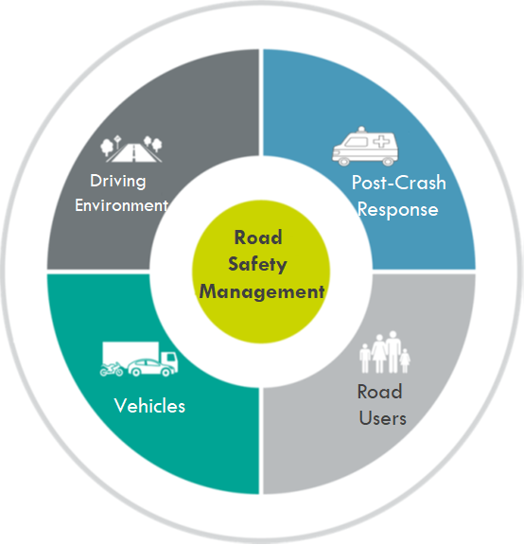
Safe Mobility: The main pillars of road safety

Slide 4
Driving Environment: The HELLASTRON Road Network
More than 2.000 Km
of Motorways have been developed the last
20 years in Greece
Applying the most recent European Road Infrastructure standards & best practices:
Double Road tunnels,
EN-1317 Safety Barriers,
Crash cushions
Incident detection systems, etc.

Slide 5
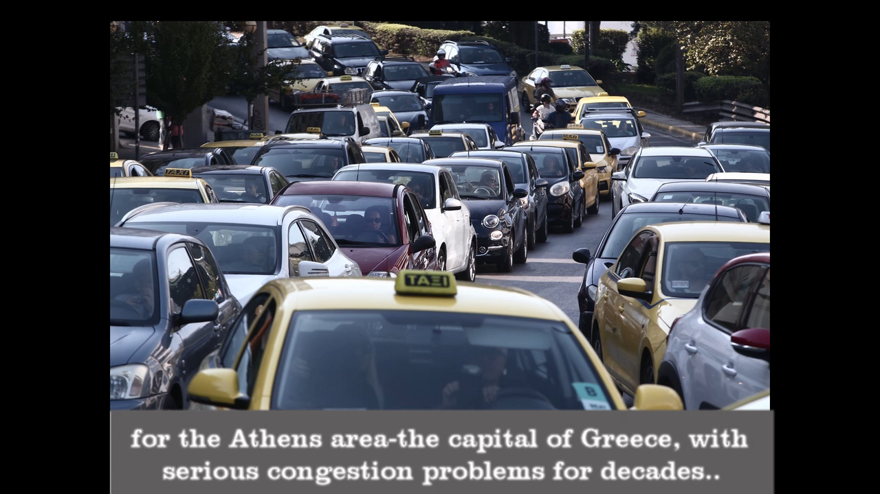
The Greek Road Network transformation in 90’’

Slide 6

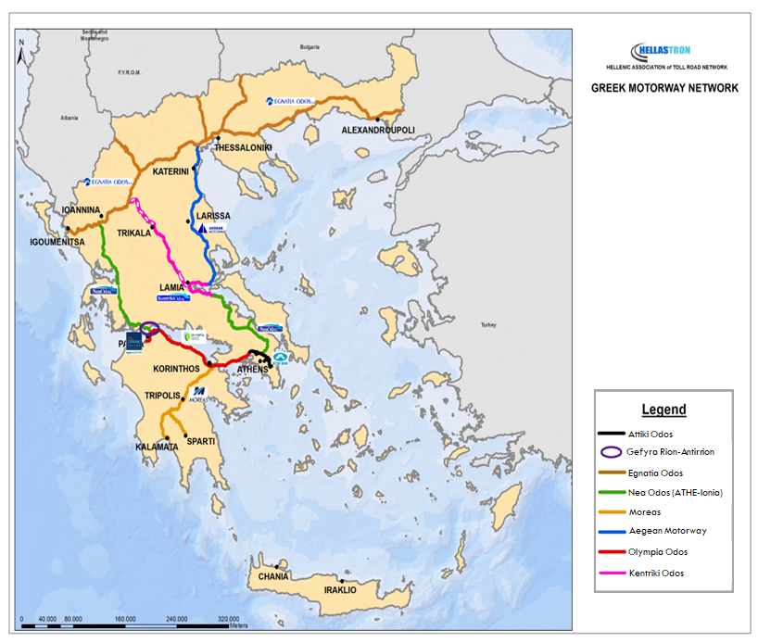
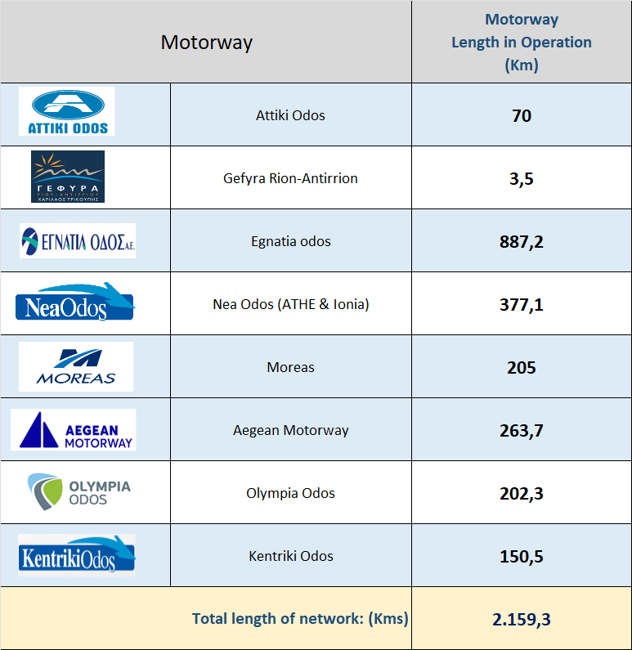
- Hellenic Association of Toll Road Network

Slide 7
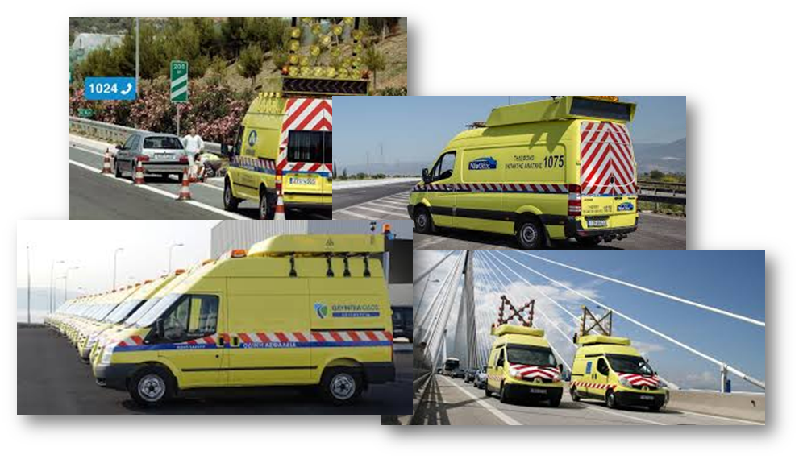
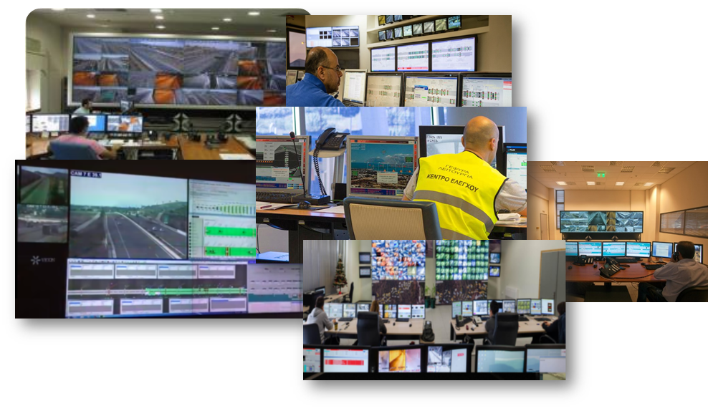
HELLASTRON – Improving the Driving Environment
Average Response Time less than:
5,6 minutes in urban areas
11,3 minutes in all other areas!
More than 20 TMCs Monitoring 2,300 kilometres in7/24/365 operation
Managing more than 110,000 Incidents per Year
More than 100 Safety Patrol units in 7/24/365 Operation

Slide 8
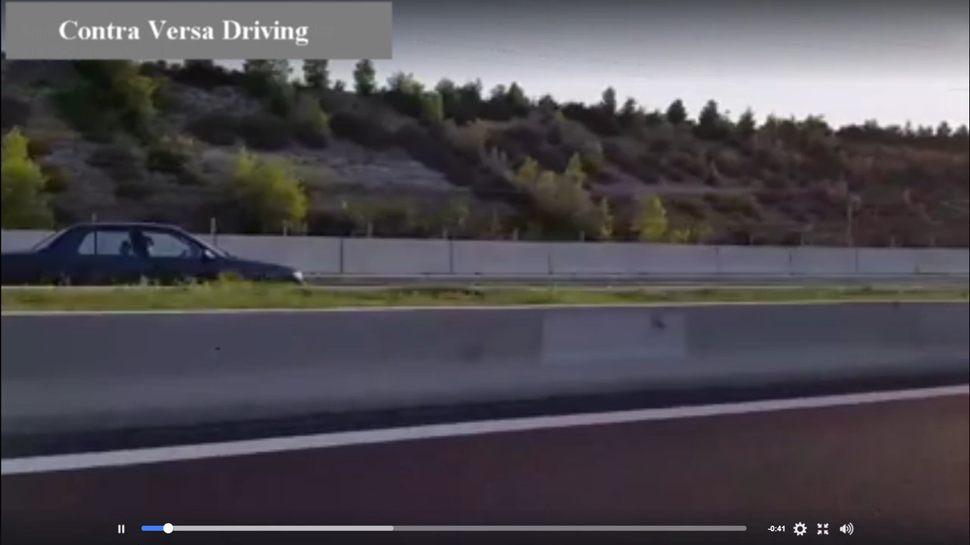
The Human Factor in road safety
Is Infrastructure Development Sufficient to Improve Road Safety?
No! Road Safety depends on Human Behaviour

Slide 9
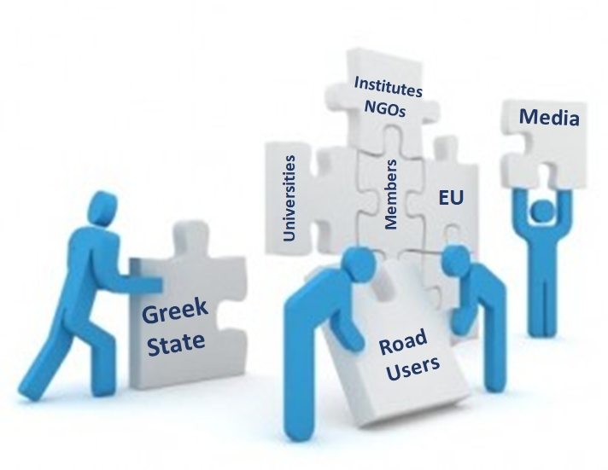
Building the road safety culture
Continuous development of Road Safety Culture is required!
(2nd Pillar)
But…Road Safety Culture Development is a demanding Team Effort

Slide 10
HELLASTRON: Our Commitment is to
Inform and Educate Users
Educate Children
(Invest in future Road Users)

Slide 11


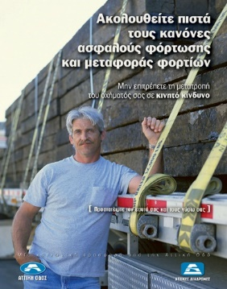






HELLASTRON: Inform and Educate Users
Road Traffic Safety Campaigns
Actions to increase awareness and change dangerous habits of users
More than 450 road traffic safety campaigns and articles by HELLASTRON members during the last ten years !

Slide 12

HELLASTRON: Inform and Educate Users, Indicative Campaigns

Slide 13
HELLASTRON: Inform and Educate Users
The numerous campaigns,
Increase the probability of success
High
Low
Although humans tend to make systematic errors in judgement and bad decisions due to ingrained ways of thinking, thoughts or preconceived notions (*),
continued education and intensive road traffic safety campaigns are used to change the balance…
(*) Cognitive Bias-Amos Tversky and Daniel Kahneman, 1972

Slide 14



HELLASTRON: Educate the Future Users
The members of Hellastron are also focusing on the education of “future users” aiming to create:
Right habits
Right thinking
Right notions
Road Traffic
Safety
…to leave the seeds of the importance of road safety…
Using:
Experiential educational programs
Interactive theatrical plays

Slide 15


HELLASTRON: Educate the Future Users
More than 1,000 activities have been implemented for the education of “future users” during the last ten years

Slide 16
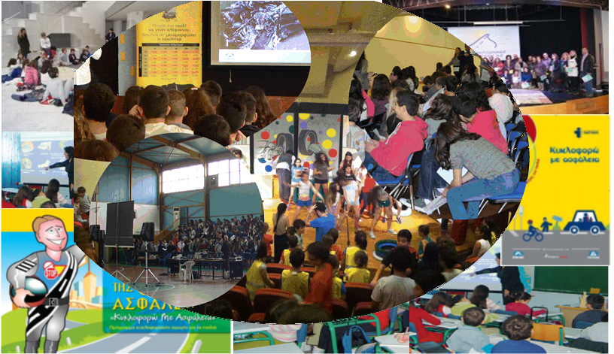
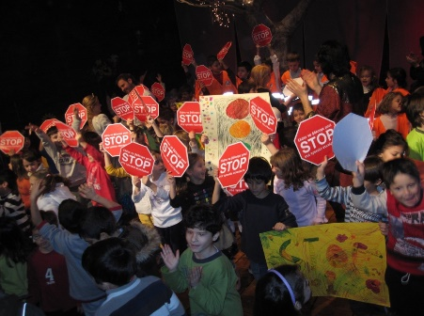
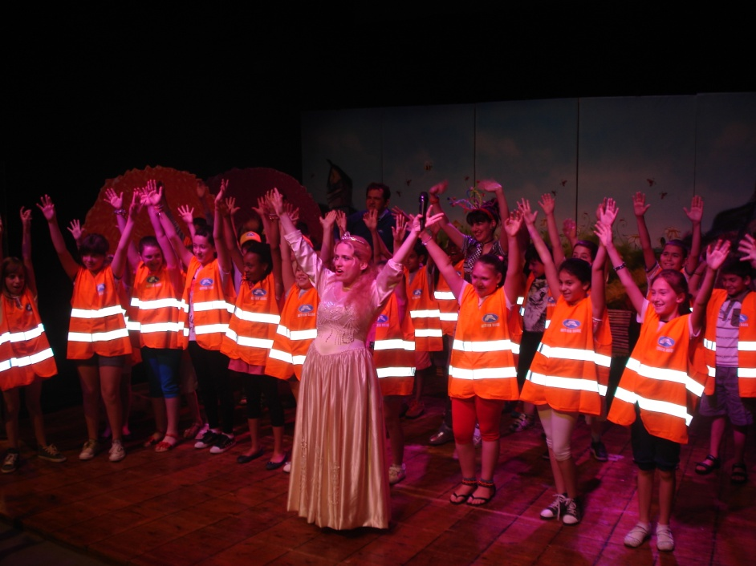
HELLASTRON: Educate the Future Users
More than 18,000 “future users” have been educated on road safety during the last thirteen years

Slide 17
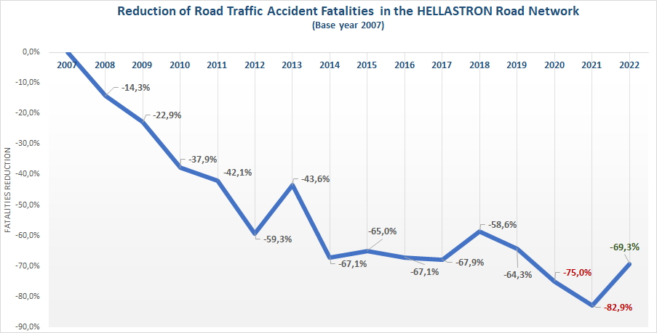
HELLASTRON Road Network: Reduction of Road Accident Fatalities

Slide 18
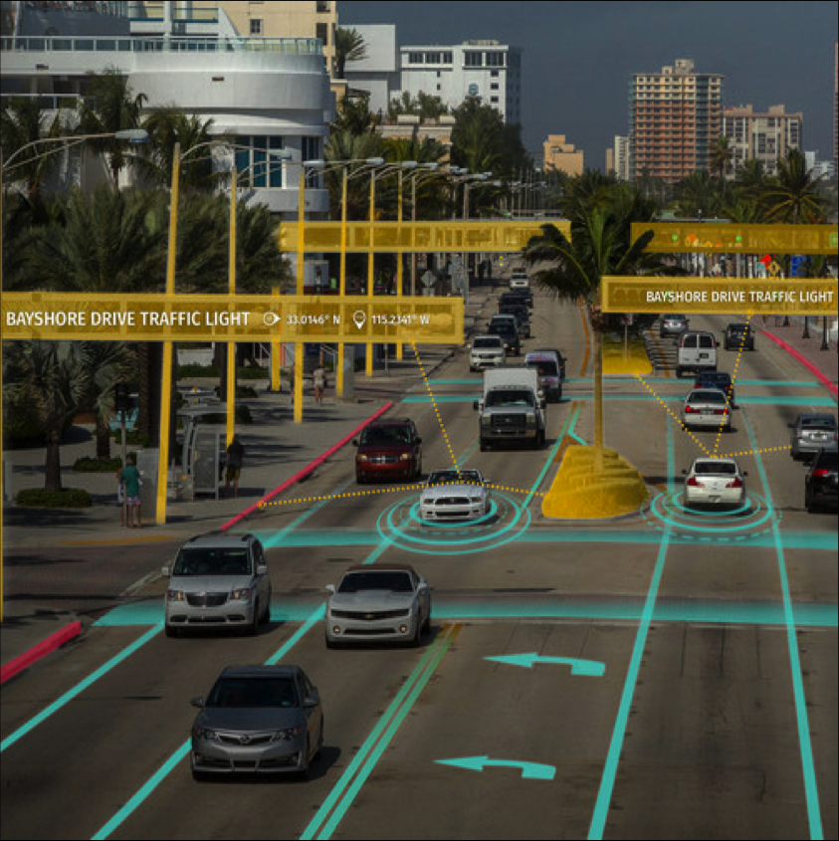
Driverless Era-New challenges for road safety
The introduction of Connected & Automated vehicles is the initiation of the transition into the "Driverless Age”
And this transition arises new issues for the Road Safety.

Slide 19
Driverless Age-New challenges for road safety
Need for huge Investments in Motorway infrastructures and operation procedures to host safely the CAVs,
New campaigns for the human resistance to release control of vehicle to a computer- Acceptance of CAV’s,
Policies and investments that will address the vulnerability of systems and lack of protection against any cyber attack
Need for State Investments to address the needs of the new era.
Who and why should fund the demanded Motorway Infrastructure?

Slide 20
Driverless Age-New challenges for road safety and Motorway Operators
The Motorway Operators will have to:
Deal with the increased maintenance costs for the new on-road equipment
Change the way of thinking and operational philosophy
Deal with the simultaneous existence of conventional vehicles and CAV’s
Educate the other stakeholders for the “Driverless Age” (society, state, etc.)
Collaborate for the development of the legal and regulative framework
the most important is that the Toll Road Industry has to define a clear approach for this transition period.

Slide 21

HELLASTRON - Priorities
At "HELLASTRON"
we believe that Road Safety
is an everyday activity that saves lives
and
returns the appropriate "VALUE"
for the TOLL paid by our users.

Slide 22
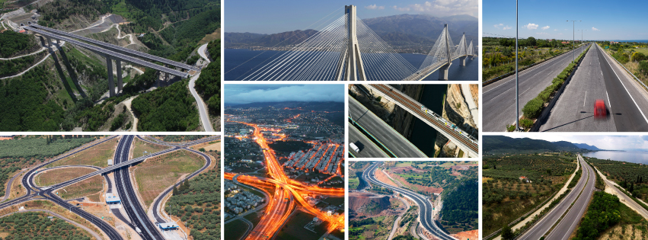
Thank you
Manos Vrailas
HELLASTRON, President,
Nea Odos/Kentriki Odos President
mvrailas@neaodos.gr

