Slide 1




43rd ASECAP Study & Information Days 2015
A Multimodal, Smart and Safe European Transport System: The Key Role of Motorways
Epic Sana Hotel
27-29 May 2015
www.asecapdays.com

Slide 2



Concrete and feasible actions for the development
and wide deployment of C-ITS
Deployment of ITS applications in Greece
HELLenic ASsociation of Toll ROad Network
(HELLASTRON)
Konstantinos Koutsoukos
General Secretary
Konstantinos Koutsoukos

Slide 3

Deployment of ITS applications in Greece
HELLenic ASsociation of Toll ROad Network
(HELLASTRON)
Creation in November 2014
1 public company – EGNATIA ODOS
7 private companies – concessionaires
ATTIKI ODOS S.A.
GEFYRA S.A.
NEA ODOS S.A.
MOREAS S.A.
AEGEAN MOTORWAY S.A.
OLYMPIA ODOS S.A.
KENTRIKI ODOS S.A.
Konstantinos Koutsoukos

Slide 4
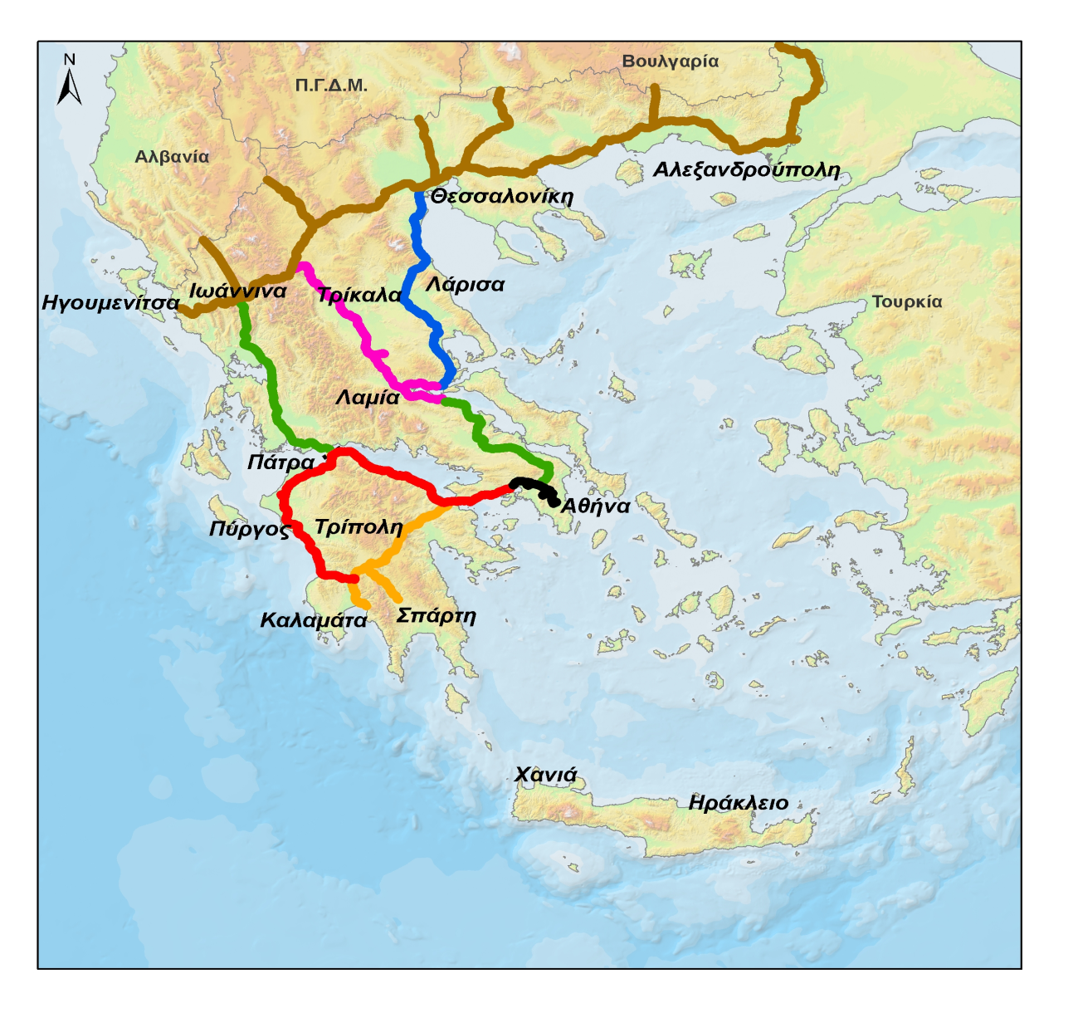
Deployment of ITS applications in Greece
First phase achievement : Eight tollway projects in Greece
Korinthos – Sparti (Μoreas)
Εlefsina -Τsakona (Οlympia odos)
Nea & Ιonia odos
Kentriki odos (Ε65)
Maliakos – Klidi (Aegean highway )
Atttiki odos
Εgnatia odos and vertical axes
Rio – Antirio bridge
Second phase achievement : Common operation for users benefit
Konstantinos Koutsoukos

Slide 5



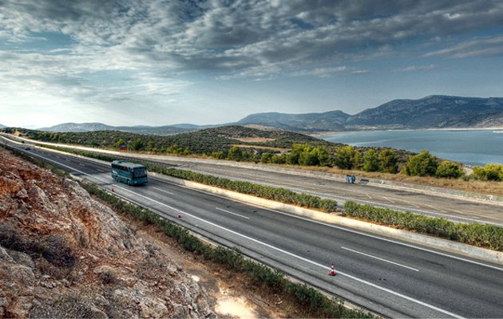
Nea odos
Attiki odos
Rio – Antirio bridge
Egnatia odos

Slide 6
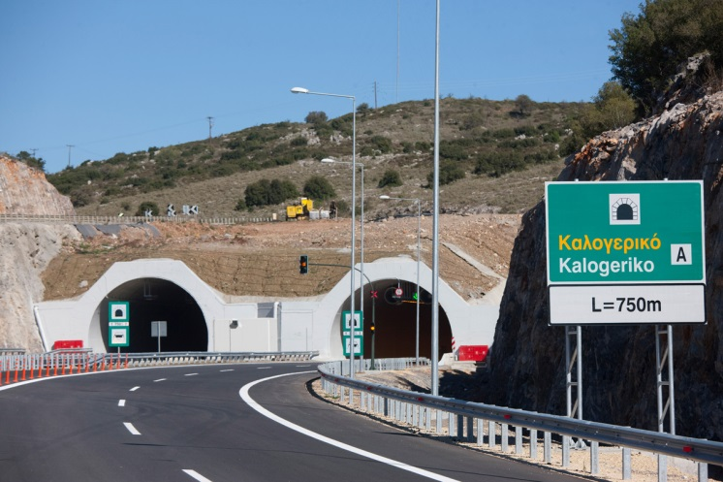
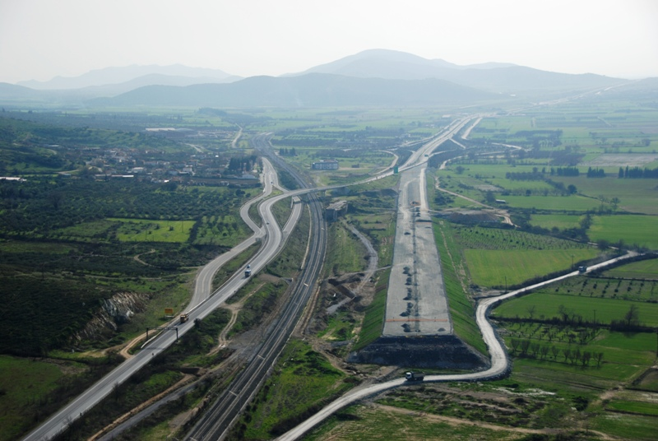
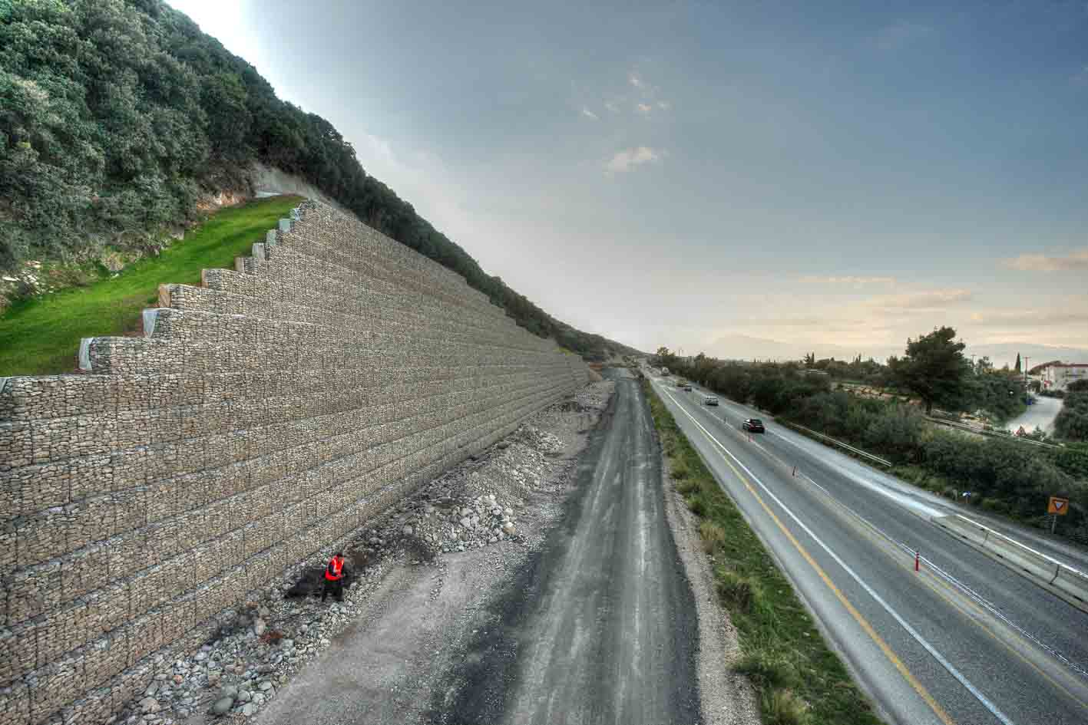

Moreas
Aegean highway
Olympia odos
Kentriki odos

Slide 7
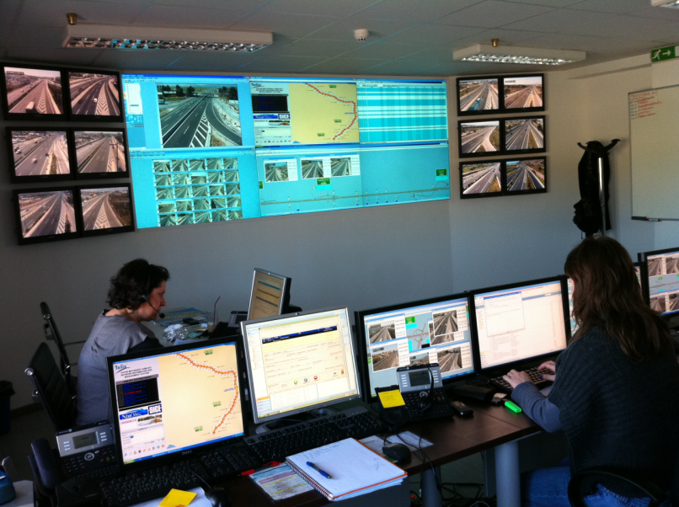
Deployment of ITS applications in Greece
Over the last twenty years many ITS installations, applied in Greek tollways
Traffic Management Centers (TMC)
    Uninterrupted 24h operation
    Modern equipment
    On-line data regarding traffic conditions via fiber optic network and CCTV
    Οn-line messages to Variable Message Signs,
    patrols, and authorities
Konstantinos Koutsoukos

Slide 8

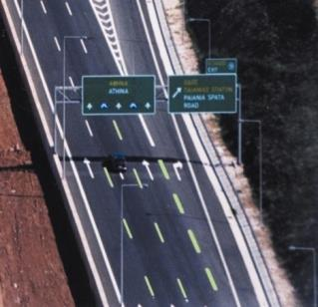
Deployment of ITS applications in Greece
Over the last twenty years many ITS installations applied on Greek highways
2. Incident detection and response systems
    Color CCTV cameras controlled by TMCs, for motorway coverage and toll plazas
    Inductive loops (traffic volume, occupancy, speed) along open motorway and in bored and cut & cover tunnels
    Algorithms for automatic detection of incidents, queues, travel time estimation
Konstantinos Koutsoukos

Slide 9
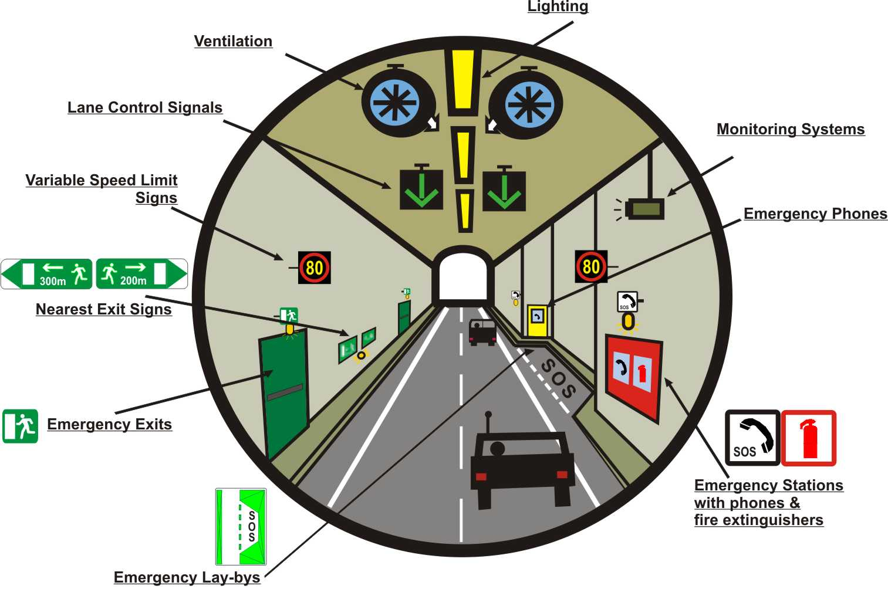
Deployment of ITS applications in Greece
Over the last twenty years many ITS installations applied on Greek highways
3. ITS systems in tunnels, according to European Directive 2004/54/EC
Konstantinos Koutsoukos

Slide 10



Efficient operation in all tollways
Weather
Emergency crews
Highway assistance
TMC
Police
Ambulance
Fire Dept.
Konstantinos Koutsoukos

Slide 11
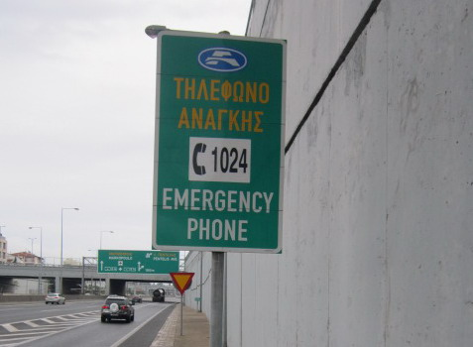

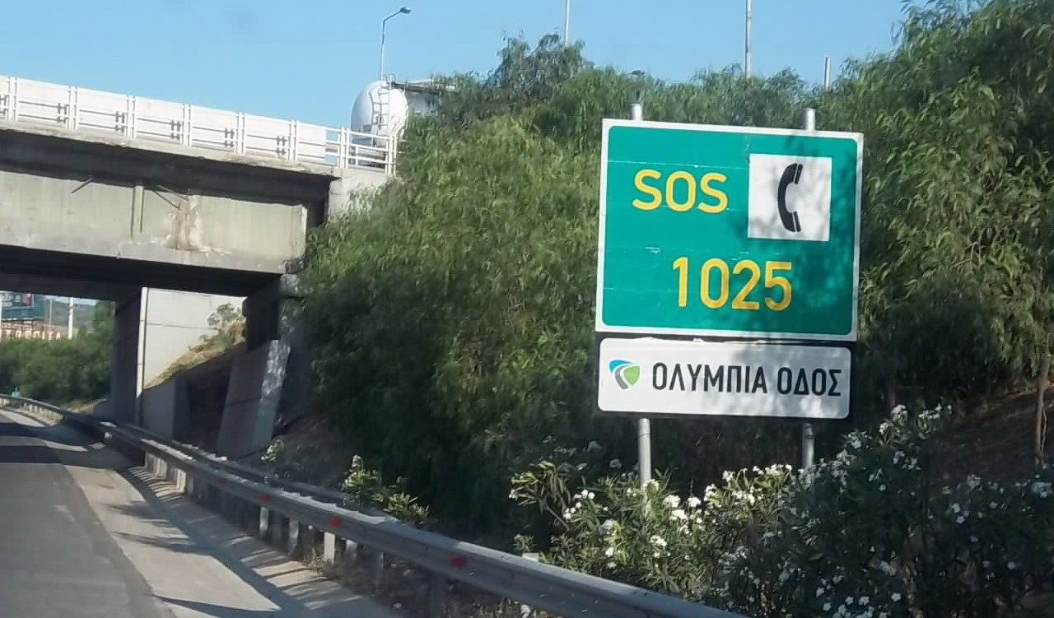
Deployment of ITS applications in Greece
Similar procedures for traffic management and toll operations along Greek tollways – different “tools”
One emergency number for all higways
Konstantinos Koutsoukos

Slide 12







Deployment of ITS applications in Greece
Similar procedures for traffic management and toll operations along Greek tollways – different “tools”
7 Tag Issuers - all CEN/TC278 A1 Compliant
Attiki Odos- e-Pass 2002
Gefyra e-Pass 2005
Egnatia – Pass 2015 (currently E-card)
Aegean Motorway– e-Way 2009
Olympia Odos – Olympia Pass 2009
Nea Odos – Fast Pass 2012
Kentriki odos – K pass 2015
Konstantinos Koutsoukos

Slide 13
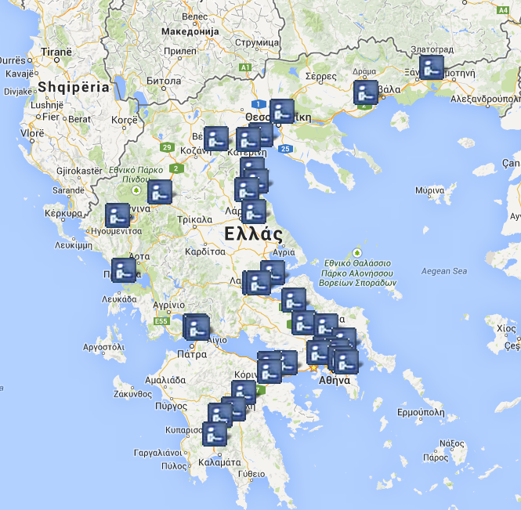
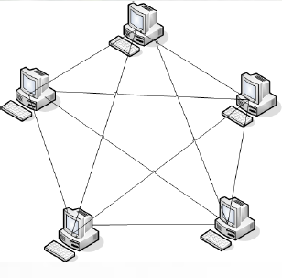
Deployment of ITS applications in Greece
Interoperability
“One contract – One Tag” principle
Currently peer to peer interoperability has achieved at a first level among five by Attiki Odos, Aegean Motorway, Gefyra, Moreas and Olympia Odos (5 Toll Chargers- 4 Tag Issuers 651.3 km network in operation today (Urban/Inter-urban Motorways and The Rion-Antirrion Bridge). Over 500.000 tags combined customer base
Next phase is to reach National interoperability, among all highways, including Nea odos, Kentriki odos and Egnatia odos
Konstantinos Koutsoukos

Slide 14
Deployment of ITS applications in Greece
Greek involvement in European ITS programs
Greece has already set up the National strategic plan for ITS, for the next ten years. Thus fulfills the obligations from the 2010/40/EU ITS directive
Easyway program, from the “deployment of systems” towards the “deployment of services” for European citizens (1995 – 2020).
Greek National Highway Fund (TEO SA), participated from the beginning, in Easyway and Easyway II programms.
Egnatia odos SA participates in EIP, EIP+ and Crocodile since March 2014, under the supervision of the Ministry of Transport
Ministry of Transport will supervise-manage the european programs, starting in January 2016.
Future involvement of HELLASTRON possible
Konstantinos Koutsoukos

Slide 15
Deployment of ITS applications in Greece
EIP and EIP +
Both EIP and EIP+ are a key players in supporting future European ITS deployment plans. combining resources from different EU actors (MS/Beneficiaries, public and private road operators) in a joint effort to ensure the creation of a proper environment for harmonizing existing and future ITS services according to EU policies and objectives, as well as building upon the achievements of the EasyWay I and II project phases.
Konstantinos Koutsoukos

Slide 16
Deployment of ITS applications in Greece
EIP + Activity for Cooperative ITS services
Cooperative Intelligent Transport System (C-ITS) are defined as a subset of the overall ITS that communicates and shares information between ITS Stations (ITS-Ss), to give advice or take actions for improving safety, sustainability, efficiency and comfort beyond the scope of stand-alone ITS. C-ITS thus represents a next logical step to improve the quality and reliability of core European ITS services.
Konstantinos Koutsoukos

Slide 17
Deployment of ITS applications in Greece
COOPERATIVE ITS SERVICES Vision
The broad admission of Cooperative ITS among road operators as core actors in an information and communication network of vehicles, infrastructure and transport users. This engagement is directed to improve operational processes to make the most out of the infrastructure, to create value for customers and market partners in order to fulfil the mobility demand of both people and goods in a safe, efficient, reliable and sustainable manner
Konstantinos Koutsoukos

Slide 18
Deployment of ITS applications in Greece
EIP + ACTIVITY 4.1
COOPERATIVE ITS SERVICES – task and deliverables
Task | Task Description (short) | Results / Deliverables
1 | Potential LoS improvement for Core European ITS Services | EIP+ White paper on C-ITS including the state of the art of C-ITS deployment, effects, and ecosystems as well as conclusions for deployment
2 | Deployment initiatives and lessons learned
3 | Cost assessment of communication media and applications
4 | Deployment scenarios for C-ITS related infrastructure and preparation of the implementation road map | C-ITS deployment road map for road authorities and operators including the mechanism for producing C-ITS deployment guidelines
5 | Mechanism for setting-up deployment guidelines for road operator responsibilities within Cooperative ITS services
6 | Sub-Activity coordination | N.A.
Konstantinos Koutsoukos

